Slide 1

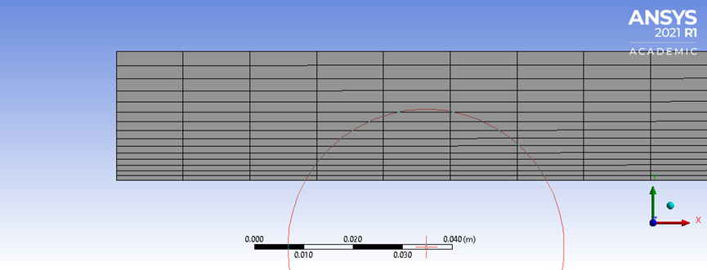
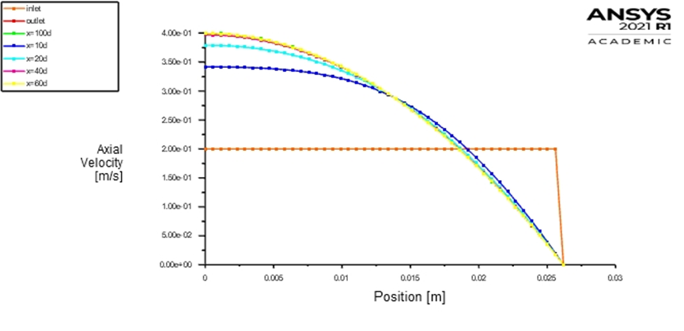
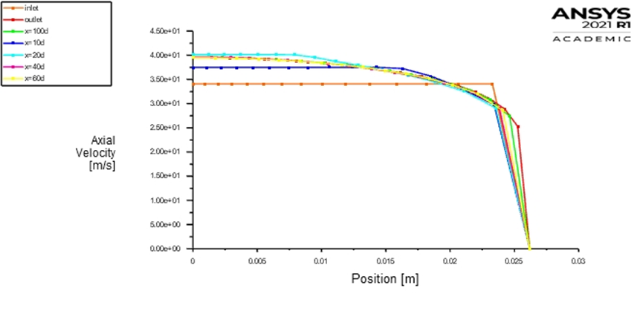
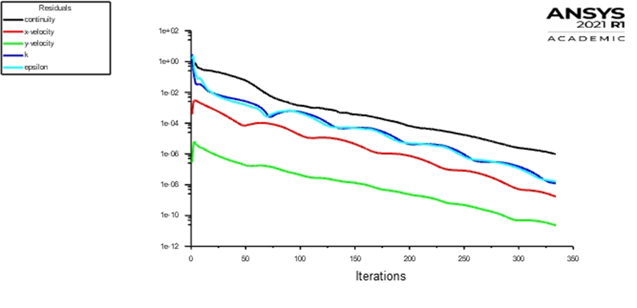
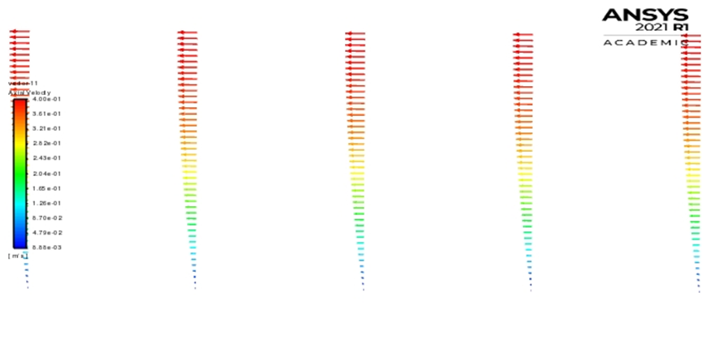
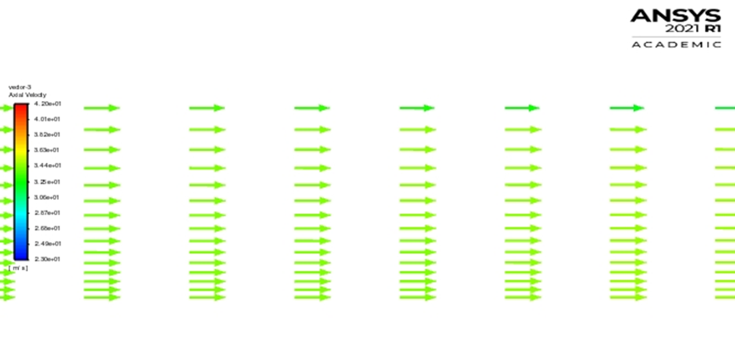
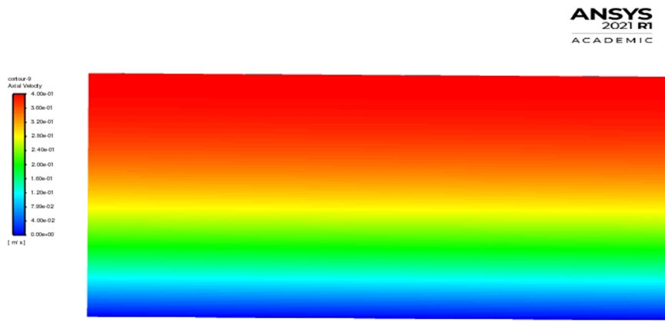
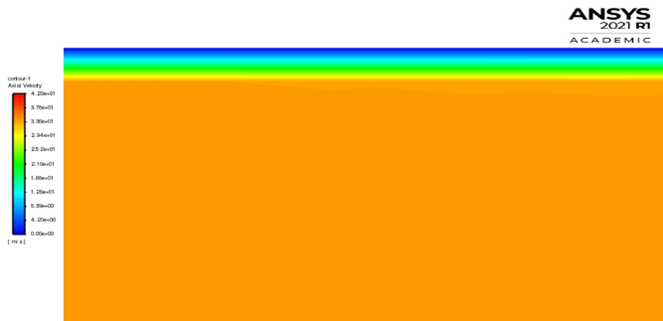
Computational Fluid Dynamics Project
Topic: Verification of Laminar and validation of Turbulent pipe flows
Introduction
Simulation Design
LAMINAR FLOW: In fluid dynamics, laminar flow is characterized by fluid particles following smooth paths in layers, with each layer moving smoothly past the adjacent layers with little or no mixing. At low velocities, the fluid tends to flow without lateral mixing, and adjacent layers slide past one another like playing cars. There are no cross-currents perpendicular to the direction of flow, nor eddies or swirls of fluids. In laminar flow, the motion of the particles of the fluid is very orderly with particles close to a solid surface moving in straight lines parallel to that surface. Laminar flow is a flow regime characterized by high momentum diffusion and low momentum convection.
TURBULENT FLOW: Turbulent flow, type of fluid (gas or liquid) flow in which the fluid undergoes irregular fluctuations, or mixing, in contrast to laminar flow, in which the fluid moves in smooth paths or layers. In turbulent flow the speed of the fluid at a point is continuously undergoing changes in both magnitude and direction. The flow of wind and rivers is generally turbulent in this sense, even if the currents are gentle. The air or water swirls and eddies while its overall bulk moves along a specific direction.
The following figure shows the sketch window you will see in ANSYS with definitions for all geometry parameters. The Ahmed body with geometry dimension in figure below.
Objective
Mesh Generation
The Purpose is to simulate steady laminar and turbulent pipe flow following the “CFD Process” by an interactive step-by-step approach. We are using ANSYS to compute axial velocity profile, centreline velocity, centreline pressure, and friction factor. we will conduct verification studies for friction factor and axial velocity profile of laminar pipe flows, including iterative error and grid uncertainties and effect of refinement ratio on verification. Students will validate turbulent pipe flow simulation using EFD data, analyse the differences between laminar and turbulent flows, and present results in CFD Lab report.
Mesh generation is the practice of creating mesh, a subdivision of a continuous geometric space into discrete geometric and topological cells. Often these cells form a simplicial complex. Usually the cells partition the geometric input domain. Mesh cells are used as discrete local approximations of the larger domain. Meshes are created by computer algorithms, often with human guidance through a GUI , depending on the complexity of the domain and the type of mesh desired.
Results
Results
Velocity profile- Velocity profiles are recorded whenever necessary to ensure that the correct speed of sound in seawater is utilized for the calibrations of the geophysical and bathymetric instruments.
Residuals- Residuals in a statistical or machine learning model are the differences between observed and predicted values of data.
Results
Velocity vector- A velocity vector represents the rate of change of the position of an object.
Velocity Contours:-A method of measuring stream discharge in which point velocity measurements are translated into average cross-sectional flow velocities by contouring the point velocities; these averages are then multiplied by the areas of the cross sections to give the discharge.
-
Dept. of Mechanical Eng., Galgotias University
Student Instructor SHIKKHA SOOD Mr. Faisal Shameem

